Slide 1
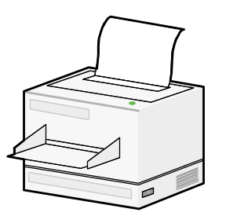
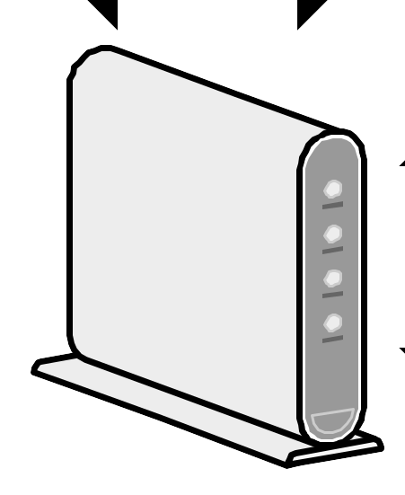

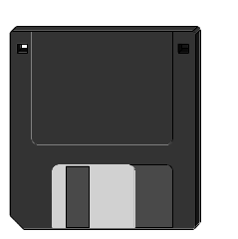
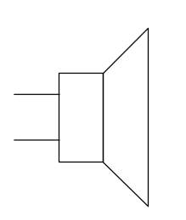
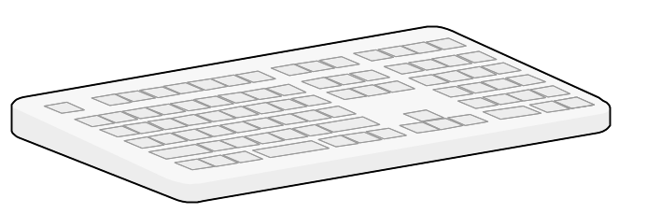

Monitor
Modem
Printer
CD ROM
CPU
Floppy
Memory
I/O Interface
Speaker
Mouse
Hard Disk
Keyboard
Computer System

Slide 2
Instruction Decoder
IR
Internal Bus
PC
MEMORY
Address
Lines
MAR
Data
MDR
Lines
RO
R(n-1)
Y
Add
Sub
ALU Control Lines
A B
ALU
Z
Single-bus organization of the Data paths inside the CPU

Slide 3
Control bus
Data bus
Address Bus
Memory
CPU
Address | Mnemonic content
$ 000 | LD R1 $00C
$ 001 | LD R2 $00D
$ 002 | ADD R3 R1 R2
$ 003 | MOV R4 R3
$ 004 | SUB R3 R2 R1
$ 005 | MOV R5 R3
$ 006 | ST R4 $ 00C
$ 007 | ST R5 $ 00D
$ 008 | HALT
----
$ 00C | 5
$ 00D | 8
PC
MAR
MDR
IR
Execution of a Machine Instruction

Slide 4
An Assembly Language Program
$000 LD R1 $00C
$001 LD R2 $00D
$002 ADD R3 R1 R2
$003 MOV R4 R3
$004 SUB R3 R2 R1
$005 MOV R5 R3
$006 ST $00C R4
$007 ST $00D R5
$008 HALT
Initially ,contents of $00C and $00D are 5 and 8, respectively.
What are the contents of Memory Locations after completion of Program?
R1=5; R2=8;
R4=13; R3=3; R5=3;
$00C=13; $00D=3;

